Slide 1
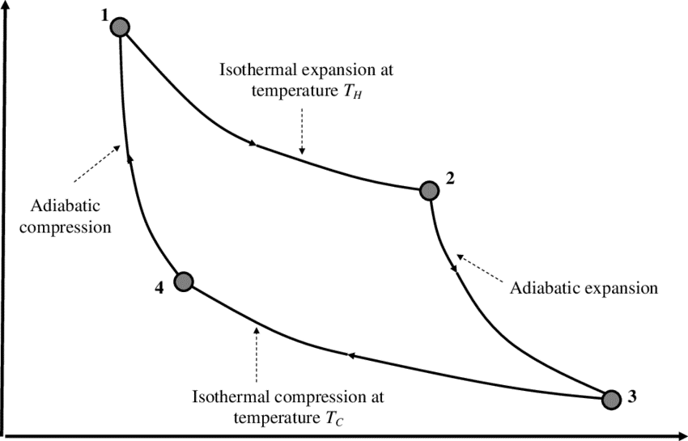


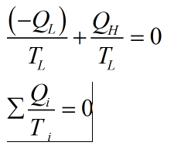
Carnot theorem 2: Every Carnot heat engine between a pair of heat reservoirs is equally efficient, regardless of the working substance employed or the operation details.
Hence using Carnot Theorem 2, we can say,

Slide 2
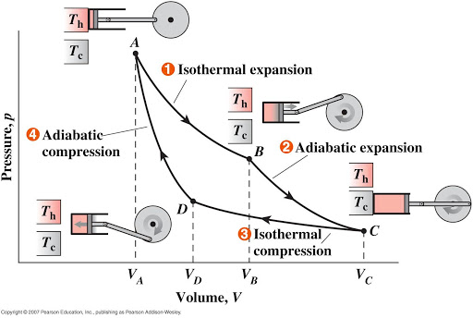
Carnot Cycle
Carnot theorem 1: All heat engines working cyclically between two heat reservoirs are less efficient than a Carnot heat engine operating between the same reservoirs.
Carnot theorem 2: All reversible heat engines between a pair of heat reservoirs is equally efficient, regardless of the working substance employed or the operation details.

Slide 3
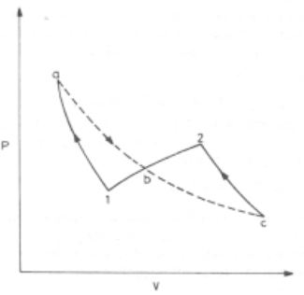
A reversible Path Equivalent to another reversible path:
Any reversible path can be replaced by two reversible isotherms sandwiching one reversible adiabatic path, provided that area(1ab) = area(bc2)
Equivalence implies: work and heat interactions for both paths are equal.
Adiabatic
reversible
Isotherm (rev)
Isotherm (rev)

Slide 4

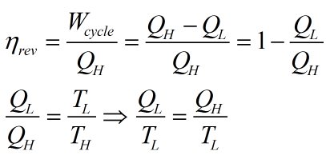
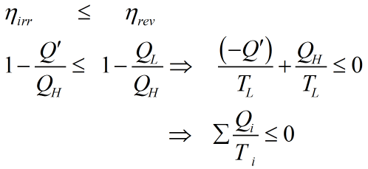
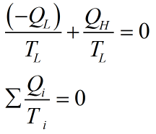
For any Reversible Cycle/device working cyclically
between two thermal reservoirs,
For any Irreversible Cycle/device working cyclically
between same thermal reservoirs,
after embedding the sign for heat w.r.t cycle/device
after embedding the sign for heat w.r.t cycle/device

Slide 5
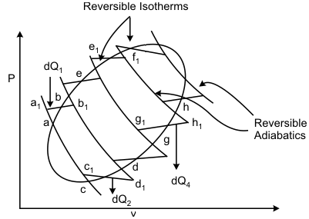


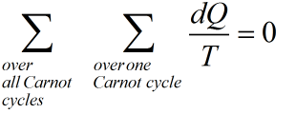



In general, any reversible cycle can be replaced by infinite number of equivalent Carnot cycles, and for each such Carnot cycle:
For example in the left diagram, for Carnot cycle 1:
4
3
Similarly we can write the above equality for other cycles 2, 3, 4 and so on…..
2
1
If we do the Summation over all such Carnot cycles, we will get
Moreover “summation” can be replaced by integral
(in the limit of infinite number of Carnot cycles, which leads to:
(where T is local temperature near a given point on cycle)
We also know that if cyclic integral of integrand is ‘ZERO’, it implies that integrand must be Δf, where f is a state function. Since each portion of our cycle is reversible, we can certainly say that :
In classical thermodynamics, we have defined this state property f as ENTROPY(S)→

Slide 6

However, if any portion of the cycle is irreversible, then for that portion of cycle, efficiency will be lesser than the Carnot cycle accounting for the above mentioned irreversible portion, which will lead to

